Slide 1
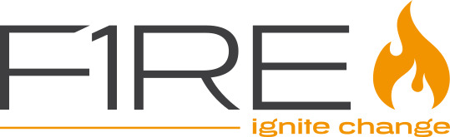
Making DSLs conversable
Krishna Narasimhan, F1RE

Slide 2
BEAT introduction
Here some slides on how we used model-driven engineering as a solution to help out the BEAT guys.

Slide 3
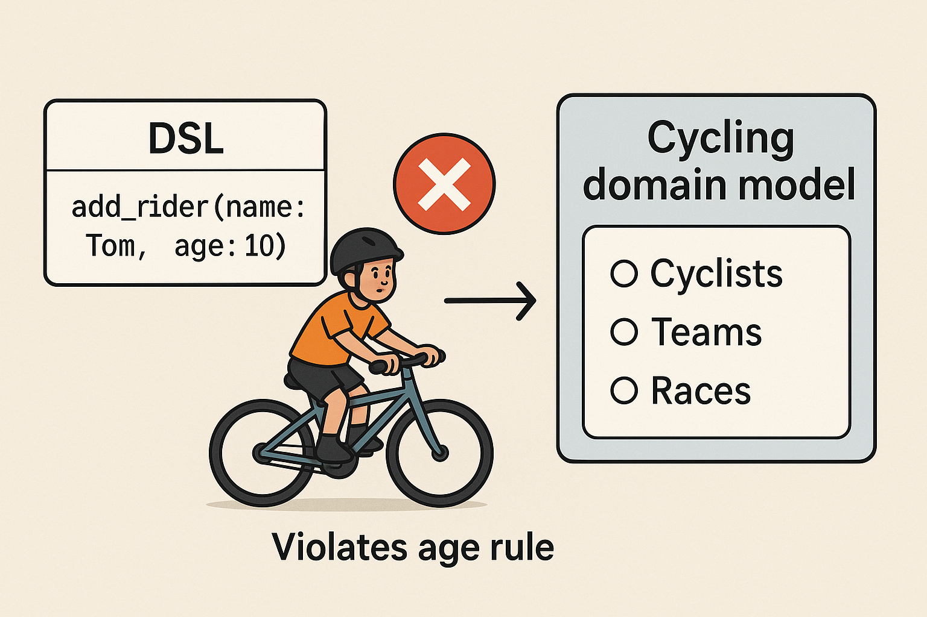
DSLs are great
Provide reliable world model
Capture business rules precisely
Enable formal verification
Makes domain logic maintainable

Slide 4
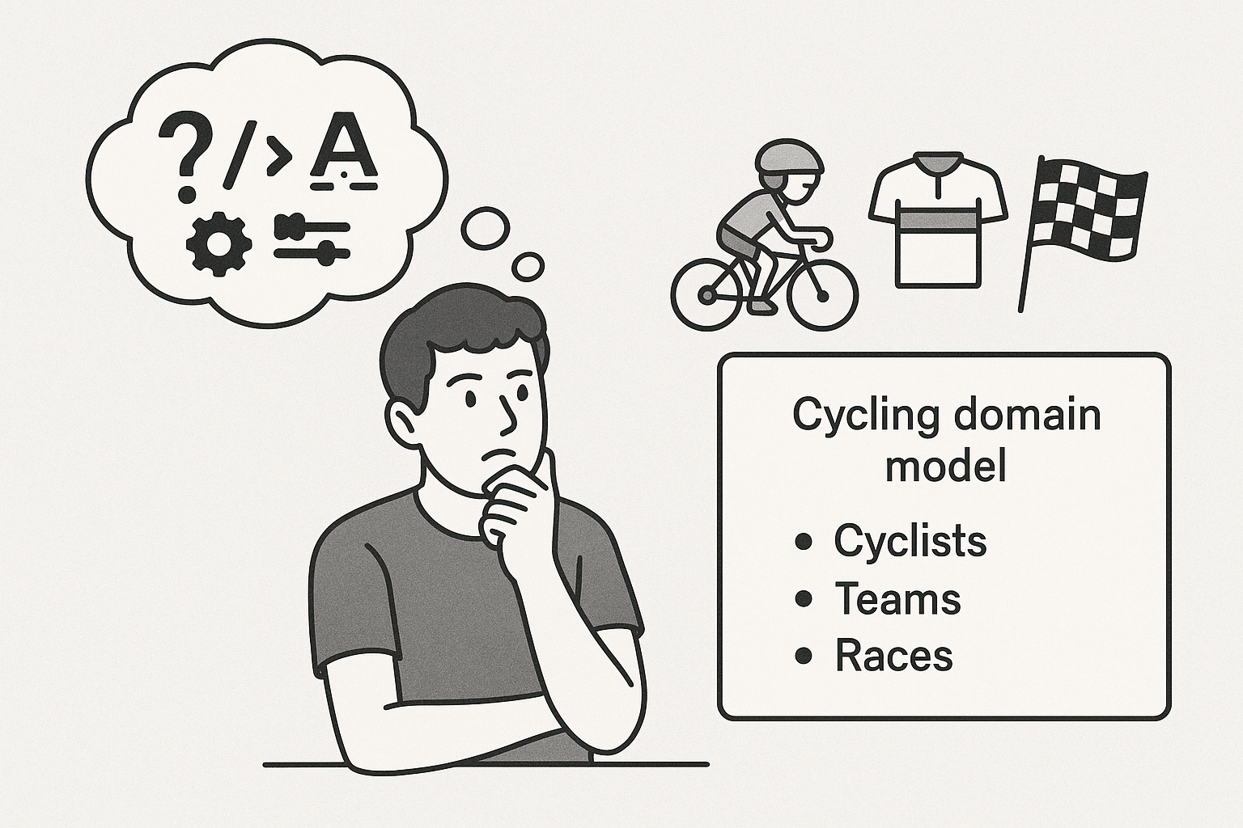
But, they have an accessibility issue
DSL syntax can be difficult to master
Can require special editors and/ or plugins
Limited documentation and tooling support
Steep learning curve before productivity

Slide 5
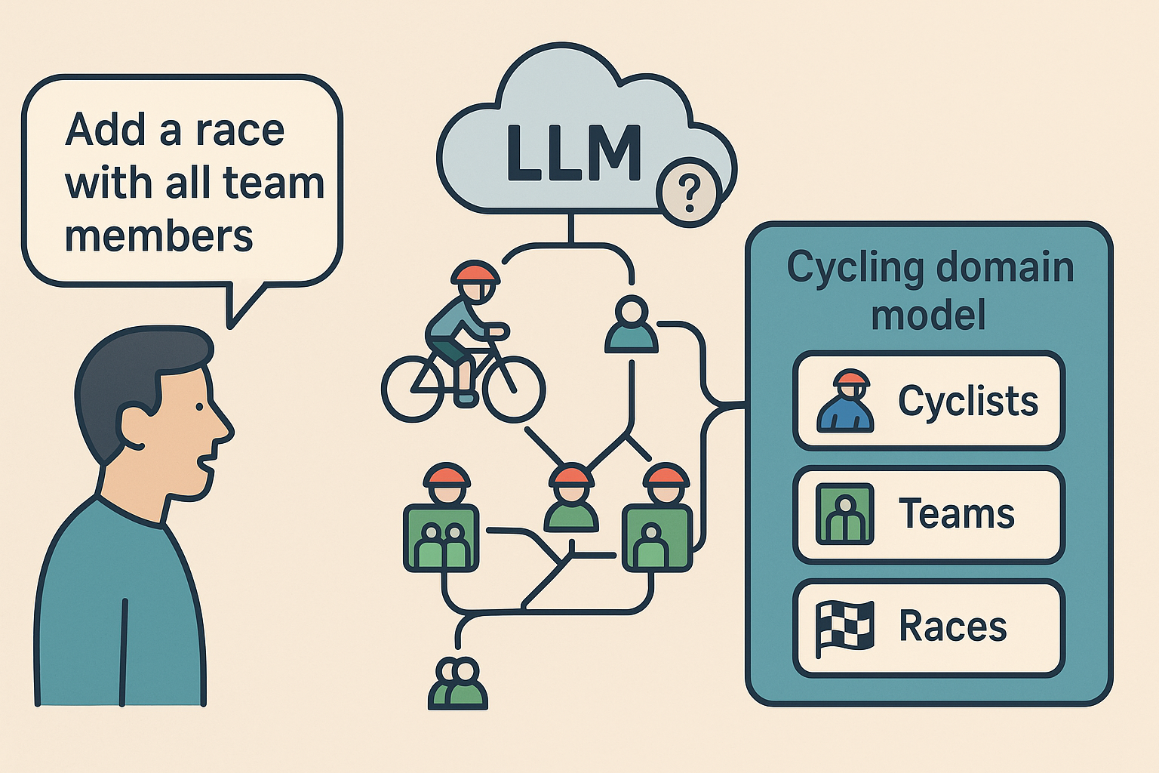
LLMs ≠ Domain Understanding
Understands words, not domain structure
Can confuse entities and relationships
No schema or rule awareness
Sounds right, can act wrong
Example: “Add a race with all team members” → mismatched or duplicate entries

Slide 6
LLMs ≠ Domain Understanding
Understands words, not domain structure
Can confuse entities and relationships
No schema or rule awareness
Sounds right, can act wrong
Example: “Add a race with all team members” → mismatched or duplicate entries
“LLMs can talk, but they don’t understand the domain.”
“LLMs can talk, but they don’t understand the domain.”

Slide 7
Can we combine them?
LLMs → accessible, natural, but unreliable
DSLs → reliable, structured, but hard to access
Can we get both — natural input and trusted execution?
What would that system look like?

Slide 8
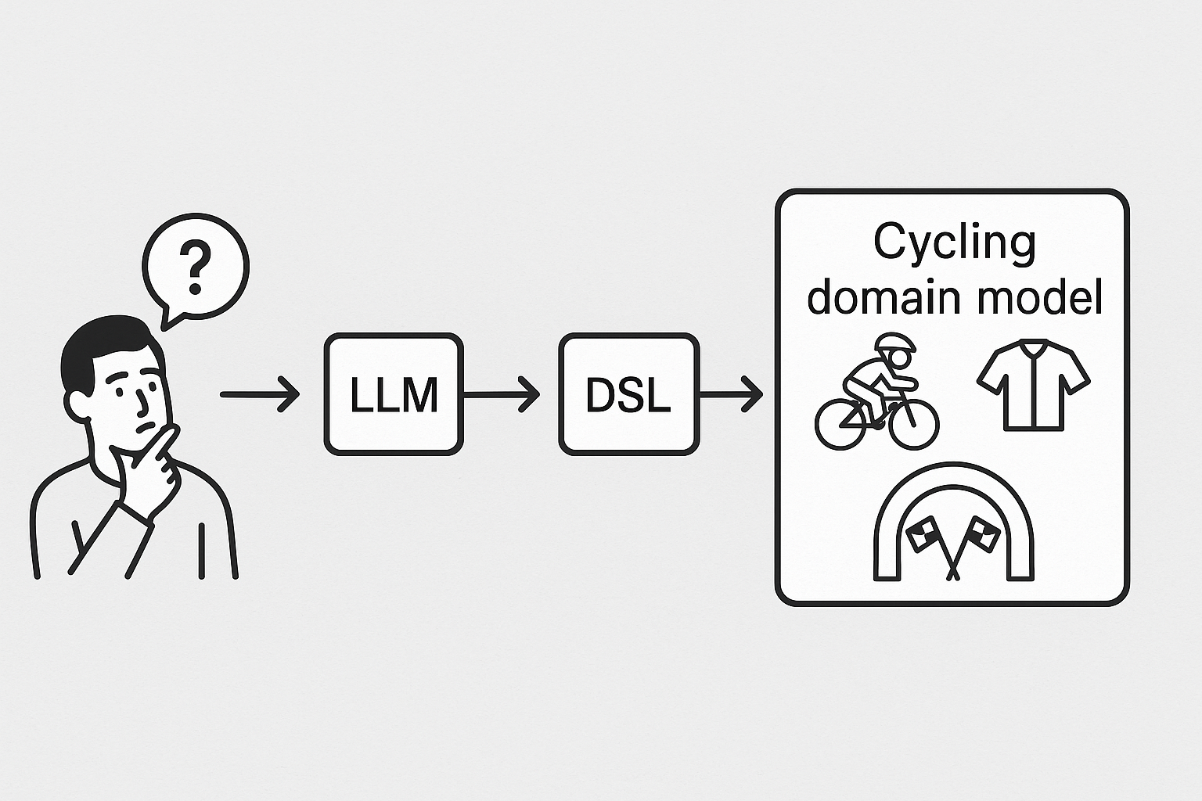
Best of both worlds – Separation of concerns
LLMs offer accessibility — natural, flexible, easy for anyone to use
DSLs offer reliability — structured, validated, rule-bound
What if each did what it’s best at?
LLMs understand intent → DSLs ensure correct execution
Together: Conversational DSLs — natural input with guaranteed validity

Slide 9
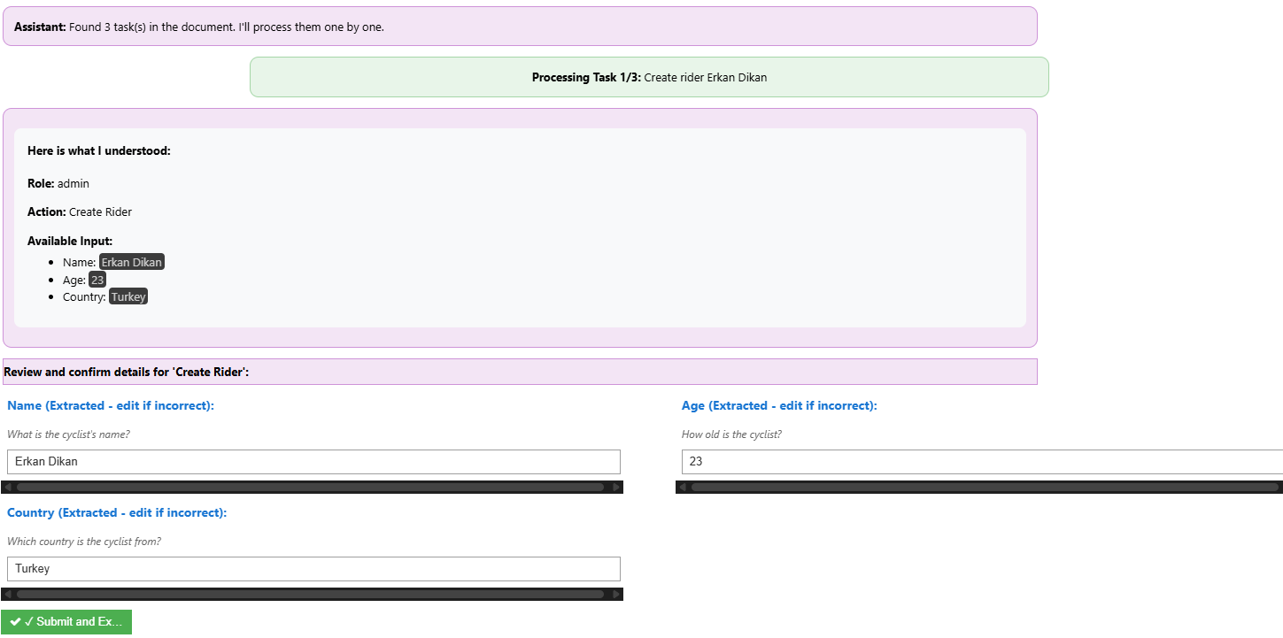
Demo (first part - to show how the envisioned system could look like)
Making the point “If we could use natural language to interact with the underlying model, this is what it would look like”.
Show how an input like this results in model change
““Let's set up the cycling team for next season. Create a rider named Erkan Dikan from Turkey aged 23. Create another rider Priya from Germany. Also create Team SkyIN from India with a budget of 20 million founded in 2010.”

Slide 10
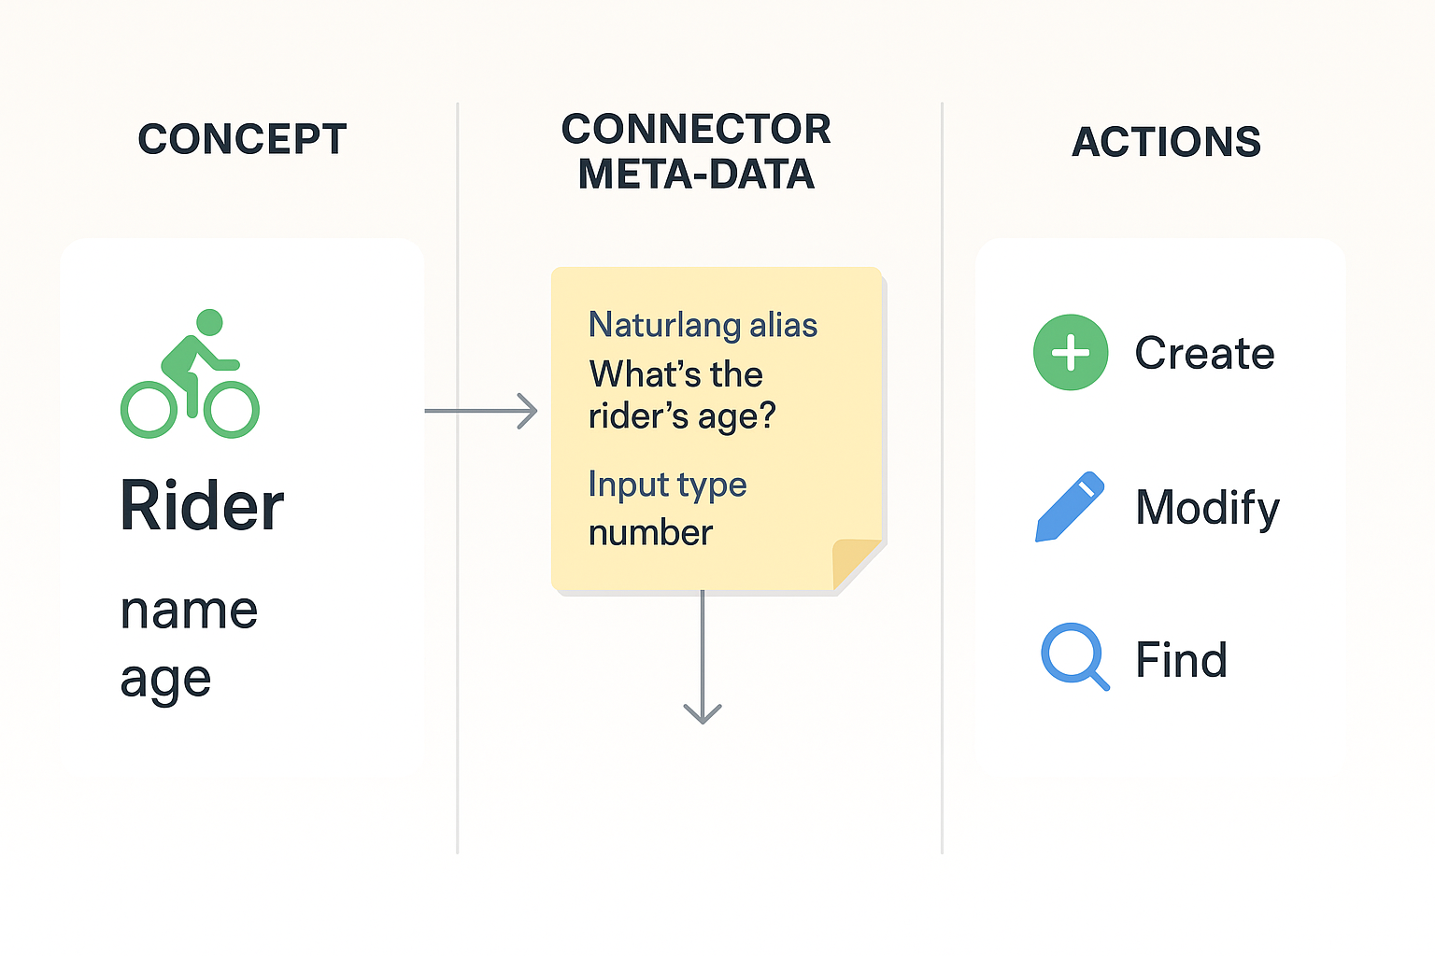
Keeping roles separate with Connector
The LLM never directly knows the domain structure.
The DSL defines the schema and logic.
The Connector exposes domain concepts (Rider, Team, Race, etc.) and actions (create, modify, find) to the LLM — but in a controlled way, with metadata like:
natural language aliases,
clarification questions,
input types,
parameter requirements.

Slide 11
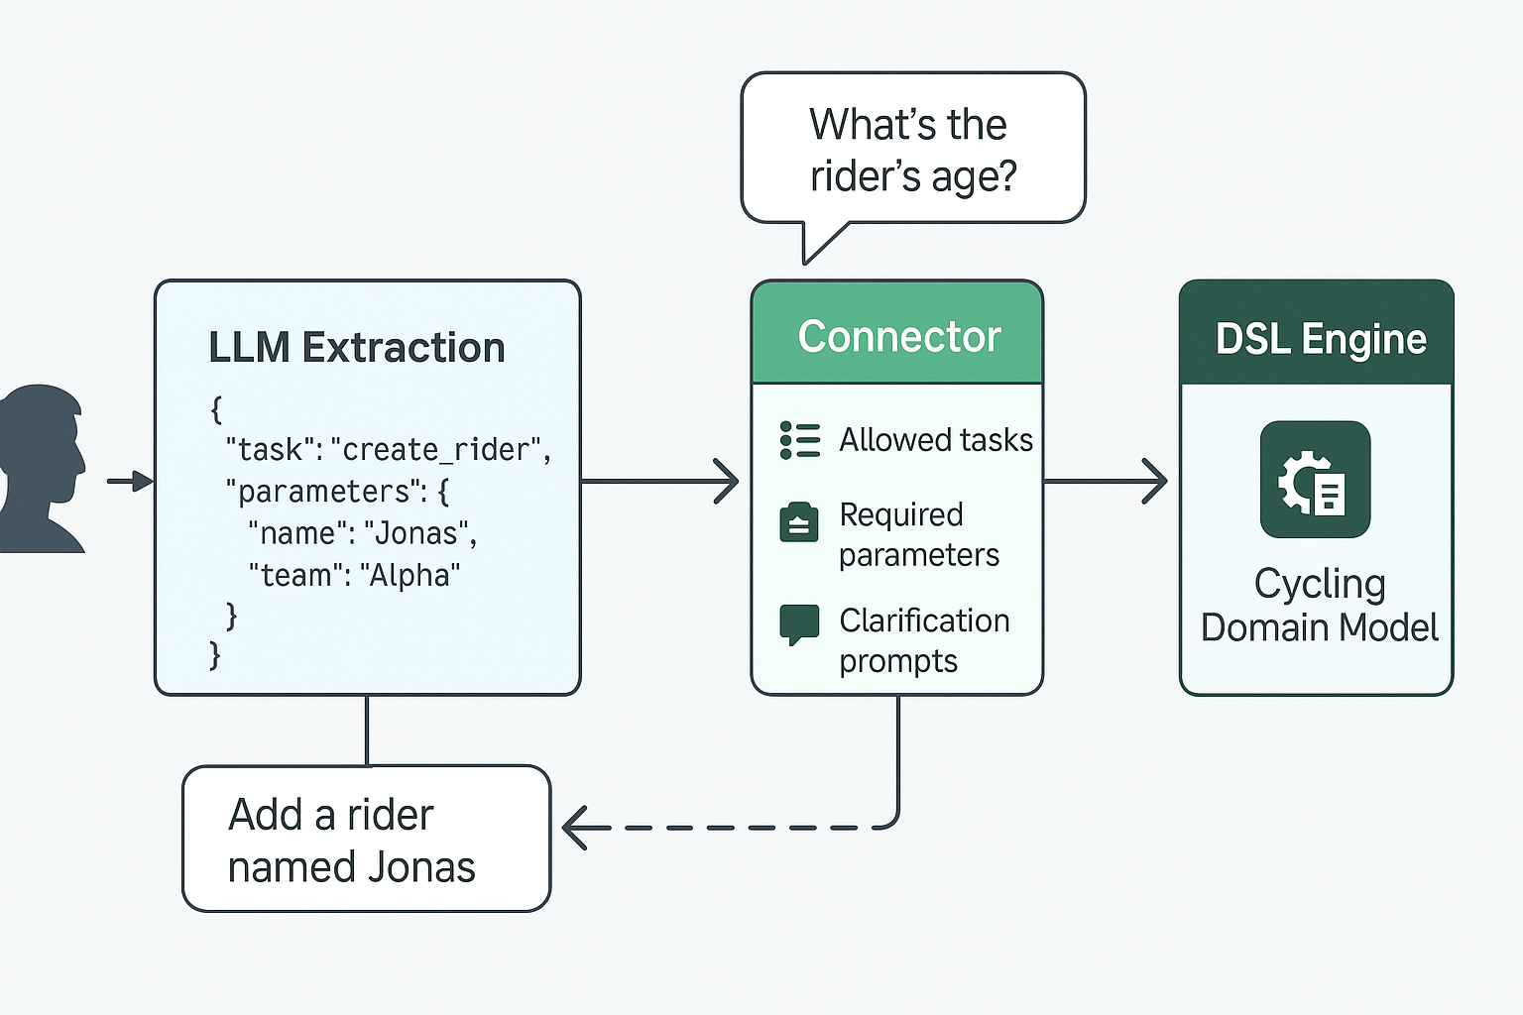
High level system design
The LLM extracts the task and parameter values from natural language
The Connector constrains the interaction to known tasks and parameters
Missing details trigger clarification prompts back to the user
The DSL Engine executes the validated action on the domain model
The Domain Model remains the single source of truth

Slide 12

Implementation
Two reference implementations
LionWeb (https://lionweb.io/)
Lark (https://lionweb.io/)
Supported model hubs:
Hugging Face
Ollama Cloud
Ollama locally hosted
https://github.com/krinara86/llm_dsl_validator

Slide 13
Demo part 2
Show multiple queries (create, modify, find) in both cycling (lionweb) and event management (lark)

